Slide 1
Cloud Computing Architecture
Presented By:
Prabin Chaudhary
BE Computer, VIII
NAST College, Dhangadhi

Slide 2
Outlines
1. Introduction to Cloud
2. Introduction to Cloud Computing
3. Cloud Computing Architecture
4. Components of Cloud Computing Architecture
5. Working Mechanism of Cloud Computing Architecture

Slide 3
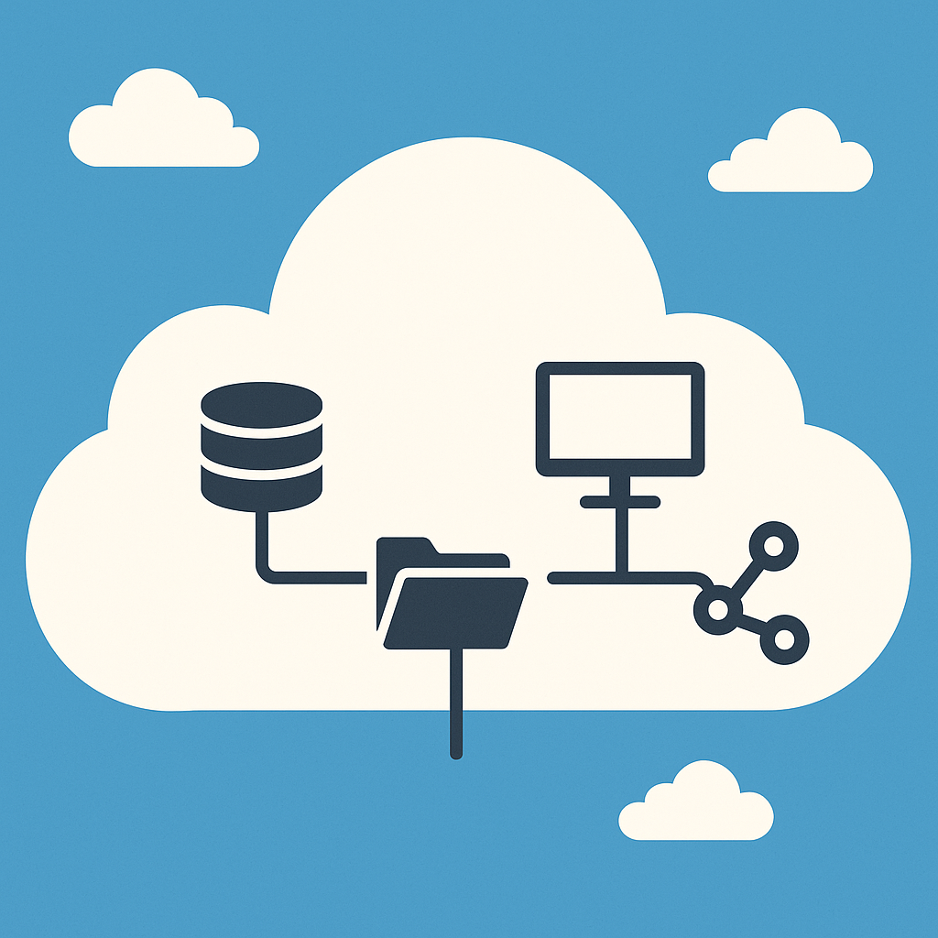
1. Introduction to Cloud
Refers to remote servers accessed via the internet.
Remote servers mean where the data lives
Example: Data stored on Google Drive.
Mainly four types of cloud: Public, Private, Hybrid and Community

Slide 4
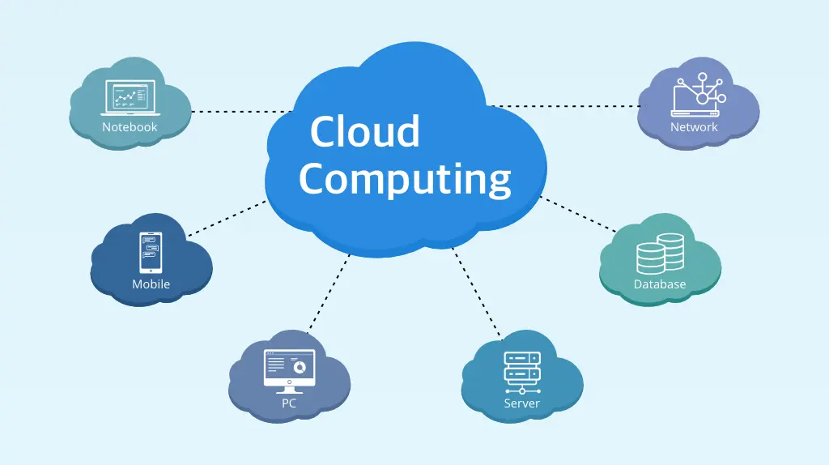
2. Introduction to Cloud Computing
Refers to the technology
That uses those remote servers to store, manage, and process data.
Example: Running a web app using AWS services.
Cloud service providers: Amazon Web Services (AWS), Microsoft Azure, Google Cloud Platform (GCP), IBM Cloud, Oracle Cloud, Alibaba Cloud and etc.

Slide 5
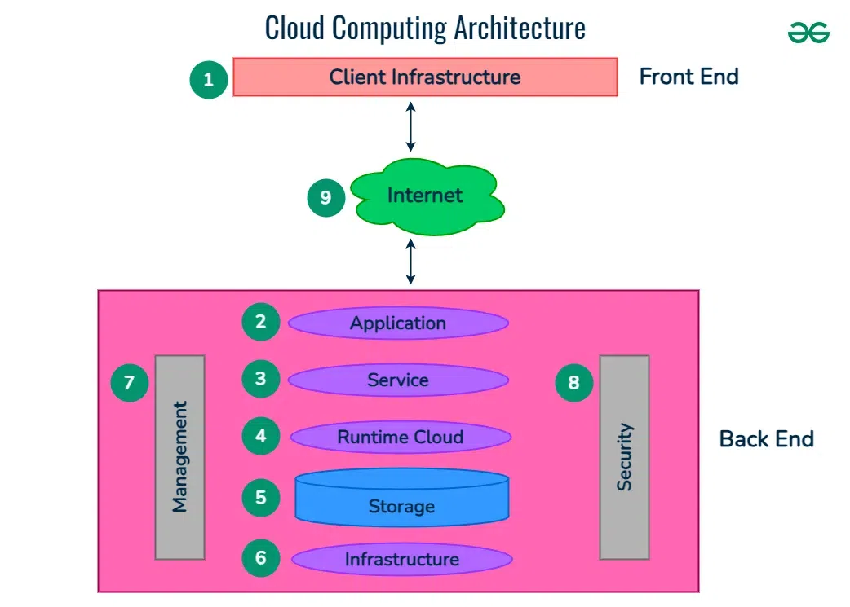
3. Cloud Computing Architecture

Slide 6
3. Cloud Computing Architecture
Typical components:
Front end ( Fat client, Thin client)
Back-end platforms ( Servers, Storage )
Cloud-based delivery and a network ( Internet, Intranet, Intercloud)

Slide 7
4. Components of Cloud Computing Architecture
Client Infrastructure: The front-end part that users interact with (e.g., browser, mobile app, desktop software).
Internet: The communication medium between client and cloud services.
Application: Software delivered as a service over the cloud (e.g., Google Docs, Gmail).
Service: The model used: IaaS (Infrastructure), PaaS (Platform), SaaS (Software).

Slide 8
4. Components of Cloud Computing Architecture
Runtime Cloud: The execution environment where applications run (e.g., servers, runtime engines).
Storage: Stores data persistently in the cloud (e.g., databases, file storage like AWS S3).
Infrastructure: Physical resources like servers, networks, and virtual machines that power the cloud.
Management: Tools and processes for monitoring, optimizing, and managing cloud services.
Security: Measures to protect data, applications, and infrastructure (e.g., encryption, firewalls, IAM).

Slide 9
5. Working Mechanism of Cloud Computing
☁️ Working Mechanism of Cloud Computing
User Request
A user sends a request via the Internet using a device (browser/app).
Cloud Network Receives Request
The request is sent to the cloud server (e.g., AWS, Azure) that hosts the service or data.
Processing the Request
Cloud runtime environment executes the application logic.
It may access storage, databases, or other services.
Service Models Used
Depending on the use:
IaaS: Virtual Machines
PaaS: Heroku, Microsoft Azure App Service
SaaS: Gmail, Google Drive
Response Delivered
The processed output is sent back to the user's device via the Internet.
Management & Monitoring
Cloud provider monitors performance, allocates resources, and ensures security.

Slide 10


Slide 11


